Slide 1


SYSTEM TEST, EVALUATION,AND VALIDATION
SYSTEMS ENGINEERING AND ANALYSIS
BLANCHARD FABRYCKY
FIFTH EDITION
MD Sarder

Slide 2
AGENDA
The Process of System Test, Evaluation and Validation
Categories of System Test and Evaluation
Planning for System Test and Evaluation
Preparation for System Test and Evaluation
System Test, Data Collection, Reporting, and Feedback

Slide 3
SYSTEM TEST, EVALUATION, AND VALIDATION
System test, evaluation, and validation activities should be established during the conceptual design phase of the life cycle, concurrently with the definition of the overall system design requirements.
The objective is to adopt a “progressive” approach that will lend itself to continuous implementation and improvement as the system design and development process evolves.
Test and evaluation activities discussed in this chapter can be aligned initially with the design activities described in Chapters 3-5 and then extended through the production construction and the system utilization and support phases.

Slide 4
Validation, as defined herein, refers to the steps and the process needed to ensure that the system configuration, as designed, meets all requirements initially specified by the customer.
These activities have been primarily directed to address early design concepts and various system elements.
However, up to this point, a total integrated approach for the validation o the system and its elements, as an integrated entity, has not been fully accomplished.
Final system validation occurs when the system performs effectively and efficiently when operating within its associated higher-level system-of-systems (SOS) configuration (as applicable).

Slide 5
1. THE PROCESS OF SYSTEM TEST, EVALUATION AND VALIDATION
As system-level requirements are identified through the definition of system operational requirements and the maintenance and support concept, a method must be established for measurement and evaluation and the subsequent determination as to whether these requirements are likely to be met.
Figure 6.1 illustrates a simplified process that can be implemented from the beginning and used in iterative way.
Initially, there are system-level requirements established, which in turn, generates the need for test and evaluation later.
This leads to the preparation of a test and evaluation master plan (TEMP), providing an overall integrated approach leading to system validation.

Slide 6
The TEMP may be updated periodically as the system design and development process evolves.
Given an initial definition of system-level requirements, the ongoing iterative process of evaluation may begin.
Early in system design, various analytical techniques may be used to predict and evaluate the anticipated characteristics of a proposed system design configuration.
CAD and related methods are often utilized to present an early three-dimensional view of a given design, showing major interfaces, accesses, size of components, human-equipment relationships, and so on.
Potential interferences and design incompatibilities readily become visible (refer to Sections 4.5 and 5.4).

Slide 7
As the design progresses to the point where mock-ups, engineering models, and proto- types are developed, the test and evaluation process becomes more meaningful because of the availability of physical models, actual hardware and software, and other elements of the system.
Further, when preproduction and production models evolve, as the system configuration approaches its intended operational configuration, the effectiveness of the test and evaluation effort assumes an even greater degree of significance.
When addressing overall test requirements at the system level, it should be realized that a true test (i.e., that which is relevant from the standpoint of assessing total system performance and effectiveness) constitutes the evaluation of a system deployed and utilized in a user operational environment, subjected to all known operating conditions.

Slide 8
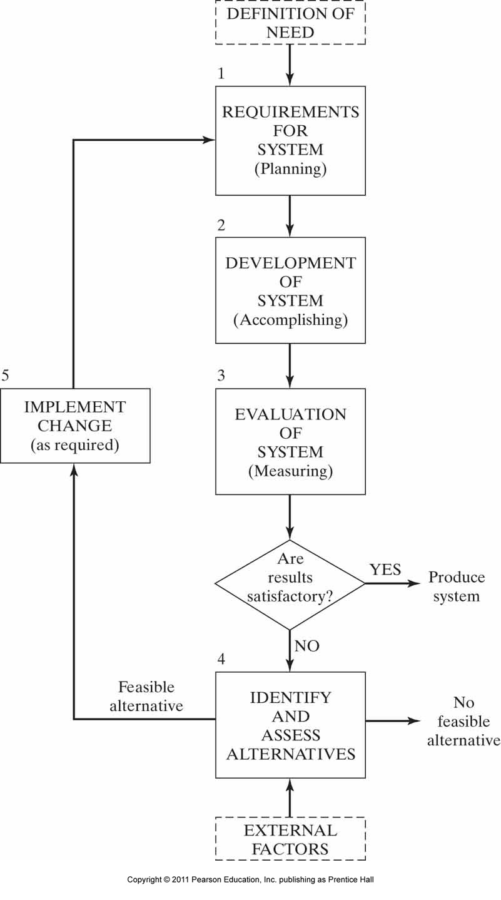
Figure 6.1 System requirements and evaluation relationships.

Slide 9
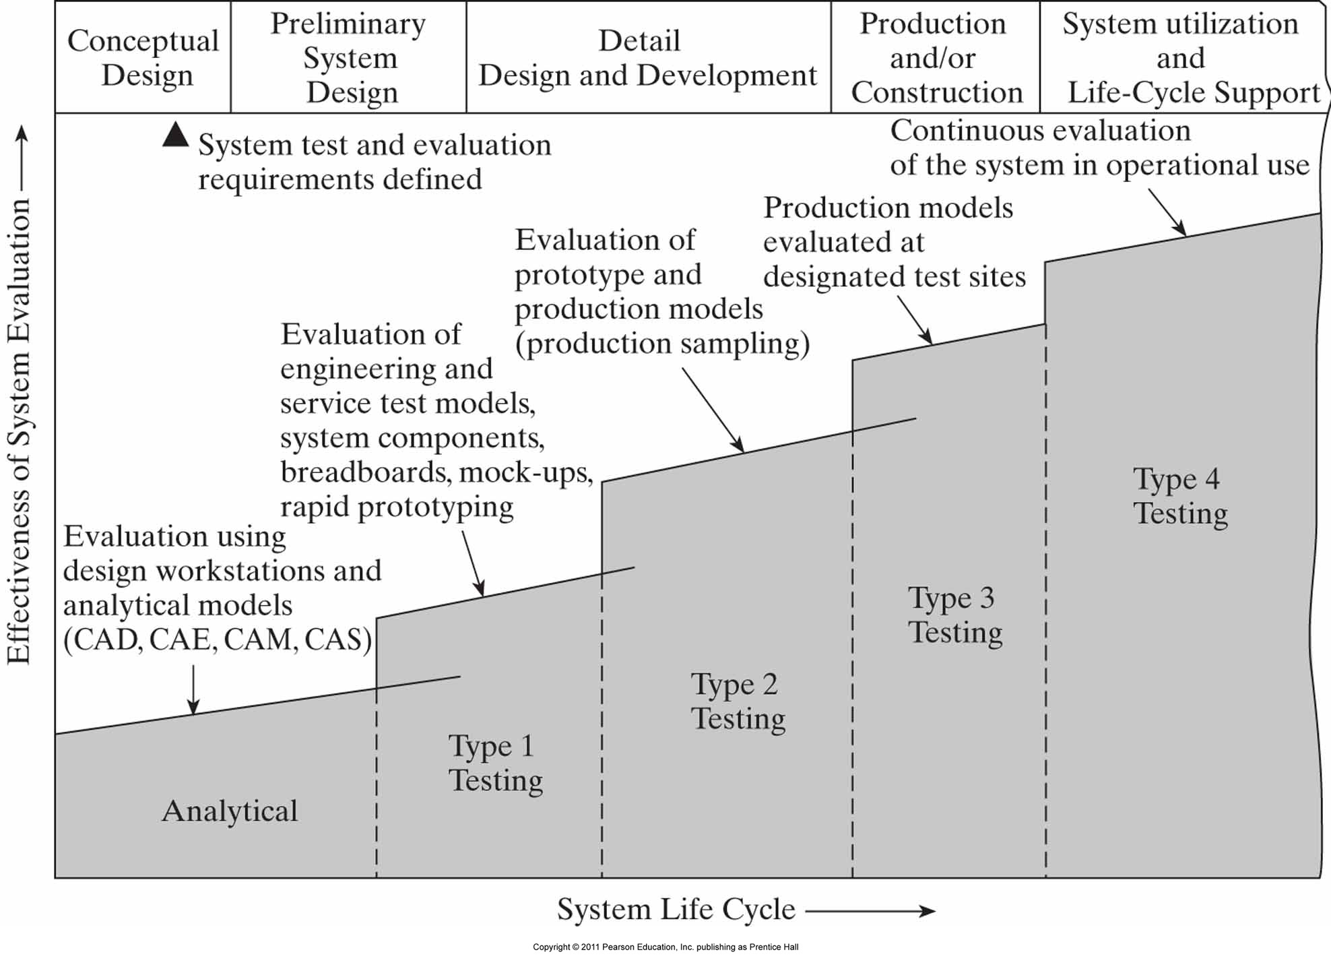
Figure 6.2 Stages of system test and evaluation during the life cycle.

Slide 10
While a true system validation effort cannot be fully completed until the system is fully operational in the user's environment, one must start early by implementing a "progressive" Test and evaluation plan, as illustrated in Figure 6.2.
The objective is to gain confidence, as early as possible, that all system requirements will be met.
Thus, the implementation of a progressive and evolving plan as shown in the figure is preferred.
The objective is to commence with the validation effort as early as possible, as long as the results obtained are meaningful.

Slide 11
2. CATAGORIES OF SYSTEM TEST AND EVALAUTION
An evolutionary approach to system test and evaluation is illustrated in Figure 6.2. Various categories of test and evaluation are identified by the program phase and the effectiveness of the evaluation effort increases when progressing through Analytical, Type 1 Testing, Type 2 Testing, and so on.
The scope and depth of testing will depend on the type of system, whether new design and development are required, the complexity of the design, and the associated risks.

Slide 12
Comprehensive testing may be required where a new design is underway the external interfaces are numerous, unknowns exist, and the risks are high.
On the other hand, commercial off-the-shelf (COTS) proven entities may not require as much testing, except to assure proper compatibility and integration with the other elements of the system.
Not too much or too little testing must be accomplished, as the consequences in either direction may turn out to be quite costly.

Slide 13
Analytical and Simulation Evaluation
The utilization of analytical models, CAD methods, and various combinations of these can be effective in the verification of certain design relationships before the design is finalized.
Analytical and simulation models are necessary in the initial phases of a program because the lack of tangible entities to subject to testing.
Through the use of simulation methods, the designer can verify certain design concepts early in the life cycle.
The objective is to gain as much visibility as possible at an early stage before the design configuration becomes relatively firm.
For an early evaluation of the river crossing bridge system, the application of CAD and the presentation of a three-dimensional spatial model could be very productive.

Slide 14
Type 1 Testing
During the initial phases of detail design, breadboards, bench-test models, engineering models, engineering software, and service test models are built and applied with the intent of verifying certain physical design, performance, and operational characteristics.
These models representing either an entire system or a designated system component, usually operate functionally (electrically and mechanically) but do not by any means represent production equipment.
In the development of software, the application of rapid prototyping is sometimes used to verify design adequacy.

Slide 15
Tests may involve operating and logistic support actions that are directly comparable to tasks performed in a real operational situation (e.g., measuring a performance parameter, accomplishing a remove-replace action, and meeting a servicing requirement).
Such testing is usually performed in the producer/supplier's facility by engineering technicians using "jury-rigged" test equipment and engineering notes for test procedures.
It is during this initial phase of testing that changes to the design can be incorporated at minimum cost.
For the river crossing bridge design, various elements of the structure can be selected for early test and evaluation to gain confidence that they will perform as intended; for example, road- and railbed materials, walkway lighting, toll facilities, and segments of superstructure.

Slide 16
Type 2 Testing
Formal tests and demonstrations are accomplished during the latter part of detail design when preproduction prototype equipment, software, formal procedures, and the like are available.
Prototype equipment/software is similar to a production configuration that will be utilized in the field but has not necessarily been fully qualified at this point in time.
A "qualified” system is one that represents a full production configuration (as approved through a Critical Design Review) that has been tested and verified through the successful completion of performance tests, environmental qualification tests (e.g., temperature cycling, shock and vibration tests), reliability qualification, maintainability demonstration, and system compatibility testing.

Slide 17
Type 2 testing primarily refers to that a associated with the initial qualification of the system for operational use, and a given test program may include a series of individual tests tailored to the need. Such a program might include the following:
Performance tests - Tests are accomplished to verify individual system performance characteristics. For instance, tests are designed to determine whether the electric motor will provide the necessary output, whether the pipeline will withstand certain fluid pressures, whether the airplane will perform its intended mission successfully, whether a production process will provide x widgets per given period, whether a health care facility will be able to process y patients in a given time frame, whether a segment of the river crossing bridge will be able to handle the expected traffic flow conditions, and s0 on. Also, it is necessary to verify form, fit, interchangeability, product safety, and other comparable features.

Slide 18
Environmental qualification - Temperature cycling, shock and vibration, humidity, wind, salt spray, dust and sand, fungus, acoustic noise, pollution emission, explosion proofing, and electromagnetic interference tests are conducted. These factors are oriented to what the various system elements will be subjected to during operation, maintenance, and transportation and handling functions. In addition, the effects of the item(s) being tested on the overall external environment will be noted.
Structural tests - Tests are conducted to determine material characteristics relative to stress, strain, fatigue, bending, torsion, and general decomposition.

Slide 19
Reliability qualification - Tests are accomplished on one or more system elements to determine the MTBF and MTBM. Also, special tests are often designed to measure component life to evaluate degradation and to determine modes of failure.
Maintainability demonstration - Tests are conducted on one or more system elements to assess the values for mean active maintenance time M mean corrective maintenance time Mct), mean preventive maintenance time (Mpt), maintenance labor-hours per operating hour (MLH/OH), and so on. In addition, maintenance tasks, task times and sequences prime equipment-test equipment interfaces, maintenance personnel quantities and skills, maintenance procedures, and maintenance facilities are verified to varying degrees. The elements of logistic support are initially evaluated on an individual basis.

Slide 20
Support equipment compatibility tests - Tests are often accomplished to verify compatibility among the prime equipment, test and support equipment, and transportation and handling equipment.
Personnel test and evaluation - Tests are often accomplished to verify the relationships between people and equipment, people and software, the personnel quantities and skill levels required, and training needs. Both operator and maintenance tasks are evaluated.
Technical data verification - Verification of operational and maintenance procedures is often accomplished.
Software verification - Verification of operational and maintenance software is accomplished. This includes computer software units (CSUs), computer software configuration items (CSCls), hardware-software compatibility, software reliability and maintainability, and related testing.

Slide 21
Supply chain element compatibility tests - The verification (in terms of adequacy) of the various elements of the proposed supply chain with the applicable elements of the system is accomplished. This includes component packaging and handling - transportation and distribution modes, warehousing and storage methods and procurement approaches.
Compatibility tests with other elements within the higher-level SOS structure (as applicable) - Selected tests of a special and unique nature may be required at the subsystem (and below) level to ensure the compatibility between specific elements of the newly designed system and external elements of other "interfacing" systems within the same SOS structure. The objective is to identify, as early as possible, areas where incompatibilities may exist and where additional design activity may be required.

Slide 22
Data output from one test may be beneficial as an input to another test.
Another aspect of Type 2 testing involves production sampling tests when multiple quantities of an item are produced.
The tests defined earlier basically "qualify" the item; that is the equipment hardware configuration meets the requirements for production and operational use.
Type 2 tests are generally performed in the producer or supplier's facility by people at that facility.

Slide 23
Type 3 Testing
Formal tests and demonstrations may be conducted following the initial system qualification testing and prior to completion of the production/construction phase.
Operational test and support equipment, operational software, operational spares, and formal system operating and maintenance procedures are used.
Testing is generally continuous, accomplished over an extended period of time, and covers the evaluation of a number of system elements scheduled through simulated operational exercises.
Type 3 testing provides the first time in the life cycle that all elements of the system can he operated and evaluated on a truly integrated basis.

Slide 24
The compatibility between the prime equipment and software, personnel and equipment/software, the elements of support with the prime components of the system, the elements of support with each other, and the elements of other systems within the same SO5 configuration is verified.
TPMs related to operational and maintenance support functions are measured and verified for compliance with the initially specified requirements.
Although Type 3 testing does not represent a complete operational situation, such testing can be planned and designed to provide a close approximation.

Slide 25
Type 4 Testing
During the system operational utilization and support phase, formal tests are sometimes conducted to gain further insight into a specific area.
It may be desirable to vary a mission profile or system utilization rate to determine the impact on total system effectiveness and on life-cycle cost, or it might be feasible to evaluate alternative support policies to see whether system operational availability (A˳) can be improved, or it may be feasible to select a different supply chain approach to improve the overall effectiveness of the logistic support capability.

Slide 26
Even though the system is designed and operational in the customer environment, this is actually the first time that we can really assess and know its true capability.
In addition, formal testing may be accomplished in conjunction with the incorporation of technology enhancements and system upgrades to ensure that the appropriate measures of effectiveness (MOEs and/or TPMs) are being maintained as system operations continue.

Slide 27
3. PLANNING FOR SYSTEM TEST AND EVALUATION
Test planning should actually commence during the conceptual design phase when the technical requirements for the system are defined.
If a system requirement is to be specified, then there must be a way to measure and evaluate the system later to ensure that the requirement has been met; hence, testing, evaluation, and validation requirements are intuitive at an early point in time.
Throughout the various stages of system development, a number of different and individual tests may be specified covering subsystems, equipment, software, or various combinations of system elements.

Slide 28
For each system development effort, an integrated test plan is prepared, usually for implementation beginning in the preliminary system design phase.
Although the specific content will vary depending on the nature, makeup, and complexity of the system, the plan will generally include the following:
An identification of all of the tests to be accomplished, the items to be evaluated, the schedule of each, required inputs and expected outputs, applicable test sequences, etc. In any event, a proposed test plan layout, such as shown in Figure 6.3, should be included.

Slide 29
An identification of the organization(s) responsible for the administration, those actually conducting the tests, and the personnel and facilities necessary to provide ongoing test support (i.e., test technicians, facilities, test and support equipment, special test jigs and fixtures, test procedures, test monitors, data collection and recording, and test reporting).
A description of the test location(s), local political/economic/social factors, logistics provisions, and the test environment (i.e., arctic, desert, mountainous or flat terrain, facilities, and safety/security provisions). Testing the system, within the context of a SOS structure involving many different and varied interfaces, will likely be accomplished at a combination of various different geographical locations. The objective herein is to convey an integrated approach illustrating the interrelationships among these different test sites (as applicable).

Slide 30
A description of the test preparation phase for each category (type) of testing as required. This includes the selection of a test method, preparation of specific test procedures, training of test and supporting personnel, acquisition of the required logistics and maintenance support infrastructure, and preparation of test site and supporting facilities.
A description of the formal test phase (i.e., personnel requirements, equipment and software requirements, facility requirements, data collection and analysis methods and test reporting).
A plan and associated provisions for retesting (i.e., the approach and methods conducting additional testing as required due to a “reject” situation, or equivalent).
A description of the final test report (i.e., format, distribution, feedback, and recommendations for corrective action as required).

Slide 31
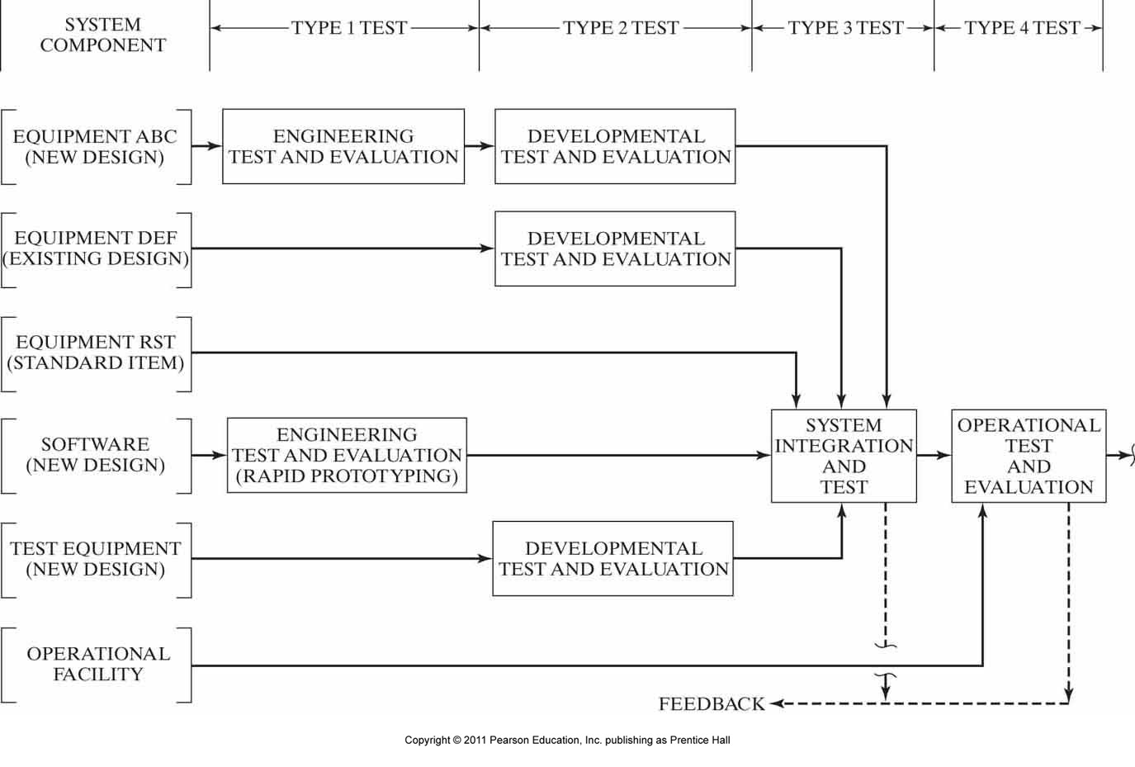
Figure 6.3 Evolution of test requirements.

Slide 32
4. PREPARATION FOR SYSTEM TEST AND EVALUATION
After initial planning and prior to the start of formal evaluation, a period of time is set aside for test preparation.
During this period, the proper conditions must be established to ensure effective results.
Although there is some variance depending on the type of evaluation, these conditions or prerequisites include the selection of the item(s) to be tested, establishment of test procedures, test site selection, selection and training of test personnel, preparation of test facilities and resources, the acquisition of support equipment, coordination with interfacing organizations when required for a SOS configuration, and the specified supply chain items necessary to ensure the successful accomplishment of the planned test program.

Slide 33
Selection of Test Item(s)
The equipment/software configuration used in the test must be representative of the operational item(s) to the maximum extent possible.
For Type 1 tests, engineering models are used that are not often directly comparable with operational equipment; however, most subsequent testing will be accomplished at such a time that equipment (or software) representing the final configuration is available.
A prerequisite task involves selecting the test model by serial number, defining the configuration in terms of incorporated versus unincorporated engineering changes (if any), and ensuring that it is available at the time needed.

Slide 34
Test and Evaluation Procedures
Fulfilment of test objectives involves the accomplishment of both operator and maintenance tasks.
Completion of these tasks should follow formal approved procedures, which are generally in the form of technical manuals developed during the latter phases of detail design.
Following approved procedures is necessary to ensure that the system is operated and maintained in a proper manner.
The identification of the procedures to be used in testing should be included in the evaluation plan. Such procedures covering the major "interface" items within a given SOS structure (i.e., the "common" functions in Figure 3.24) must also be included for Types 3 and 4 testing as applicable.

Slide 35
Test – Site Selection
A single test site may be selected to evaluate the product in a designated environment; several test sites may be selected to evaluate the product under different environmental conditions (e.g., arctic versus tropical areas, mountainous versus flat terrain), or a variety of geographical locations may be selected to evaluate the product in terms of different markets and user conditions.
This may also include a designated location where other elements within the same SOS configuration structure are operating.
Any one or combination of these methods may be appropriate, depending on the product type and program requirements.

Slide 36
Test Personal and Training
Test personnel will include,
individuals who actually operate and maintain the system and equipment during the test, and
the supporting engineers, technicians, data recorders, analysts, and test administrators, as appropriate. Individuals assigned to the operation and maintenance of the system should possess the backgrounds and skill levels similar to consumer (i.e., user) personnel who will normally be assigned to operate and support the system throughout its life cycle. The required proficiency level(s) is attained through a combi- nation of formal and on-the-job training.

Slide 37
Test Facilities and Resources
The necessary facilities, test chambers, capital equipment, environmental controls, special instrumentation, and associated resources (e.g., heat, water, air conditioning, gas, telephone, power, and lighting) must be identified and scheduled. In many instances, new design and construction are required, which directly affects the scheduling and duration of the test preparation period.
A detailed description of the test facility and the facility layout should be included in test planning documentation and in subsequent test reports.
Additional facilities and resources required to support any testing of the system and its external interfaces must also be identified (i.e., for a system operating within a SOS structure).

Slide 38
Test and Support Equipment
During the latter phases of design, the necessary support items are procured and should be available for Types 2-4 testing.
In the event that the proper type of support equipment is not available and alternative items are required, such items must be identified in the test and evaluation plan.
The use of alternative items generally results in distorted test data (e.g., maintenance times), tends to cause personnel-induced failures in the system, and often forces a change in test procedures and facility requirements.

Slide 39
Test Supply Support
Supply support constitutes all materials, data, personnel, and related activities associated with the requirements, provisioning, and procurement of spare and repair parts and the sustaining maintenance of inventories for support of the system throughout the planned system testing cycle. This basically includes all of the required supply chain items that have been identified for the "operational" system and need to be available for evaluation along with the prime elements of the system. Specifically, this section addresses the following:

Slide 40
Initial and sustaining requirements for spares, repair parts, and consumables for the prime elements of the system. Spares are major replacement items and are repairable while repair parts are nonrepairable, smaller components. Consumables refer to fuel, oil, lubricants, liquid oxygen, nitrogen, and so on.
Initial and sustaining requirements for spares, repair parts, material, and consumables for the various elements of logistic support (i.e., test and support equipment, transportation and handling equipment, training equipment, and facilities).
Facilities and warehousing required for the storage of spares, repair parts, and consumables. This involves consideration of space requirements, location, and environmental needs.

Slide 41
5. SYSTEM TEST, DATA COLLECTION, REPORTING AND FEEDBACK
As a prerequisite to system testing, supported by proper data handling, it is essential that the place of verification and validation in the technical aspect of the project cycle be understood and accepted.
The objective is to start with user needs and end with a user-validated system. The systems engineering process model that best makes this objective visible is the vee" model illustrated in Figure 2.5(d).
As shown, verification and validation progresses from the component level to validation of the operational system.
At each level of testing. the originating specification and requirements documents (on the left side of the "vee") are consulted to ensure that components, higher-level system elements, and the system itself meet the specifications.

Slide 42
Formalizing Data Collection and Handling
With the necessary prerequisites established, the next step is to commence with the formal test and demonstration of the system.
To accomplish a complete validation of the system as an entity (through the completion of type 3 and 4 tests as identified in Figure 6.2-also, refer to Blocks 3.4 and 4.4 in Figure 2.4) requires that the system be operated and maintained in a manner as prescribed by the applicable test plan, simulating a realistic user's operational environment to the maximum extent practicable.

Slide 43
Providing answers to these questions requires a comprehensive and formalized data collection, analysis, reporting, and feedback capability. The establishment of such a capability involves a two-step process:
The identification of the requirements and applications for such a capability; and
The design, development, and implementation of a capability that will be responsive to these requirements.
The first step requires an understanding of the characteristics of the system that require evaluation and assessment.
While there are many different data collection subsystems in existence and currently being applied for system assessment purposes, much of the data actually being collected does not provide the information needed for the purposes intended.
Thus, the feedback as to what is really happening for many systems in the field today is lacking.

Slide 44
Figure 6.4 is presented (as an example) to show some of the objectives of a complete system validation effort. It should be noted that it is important to address not only the prime mission- related elements of the system but the logistics and maintenance support infrastructure as well.
With the data requirements defined, the second step is to develop the appropriate forms and the process for data collection, analysis, reporting, and feedback.
These forms should be simple to understand and complete, as the tasks of recording the data in the field may be accomplished under adverse environmental conditions (in the rain, wind, cold, Cramped conditions, etc.) and by a variety of personnel with different skill levels.

Slide 45
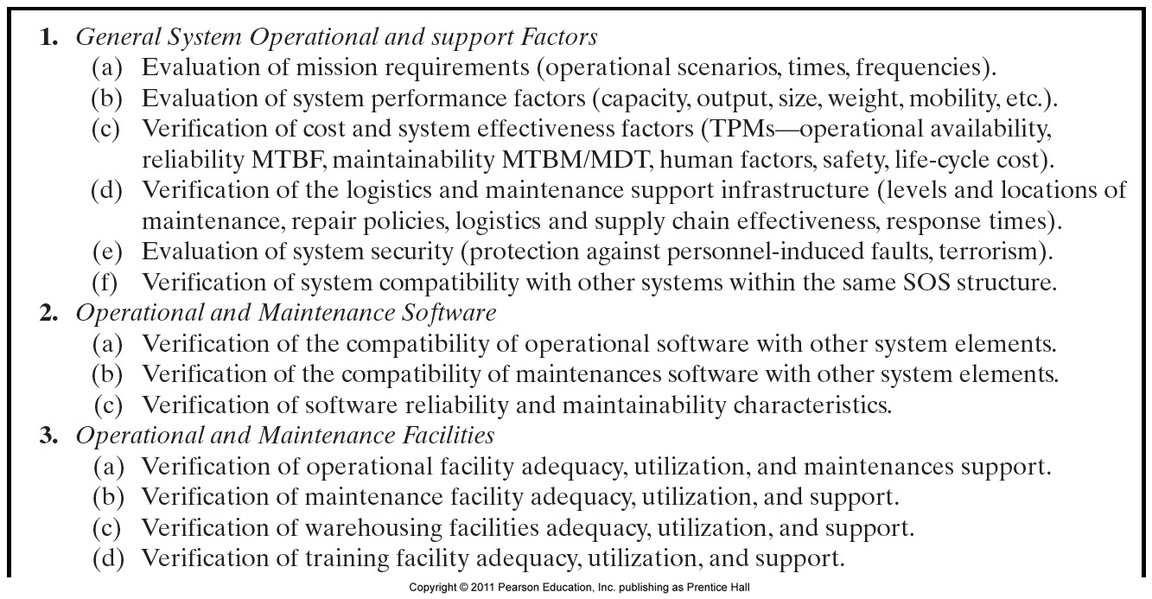
Figure 6.4 System test, evaluation, and validation checklist (example).

Slide 46
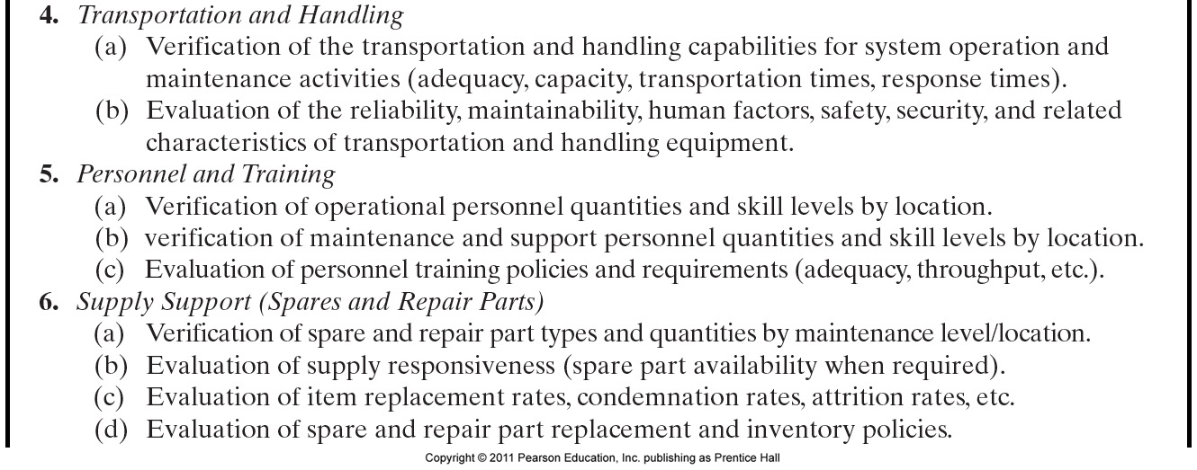
Figure 6.4 (continued) System test, evaluation, and validation checklist (example).

Slide 47
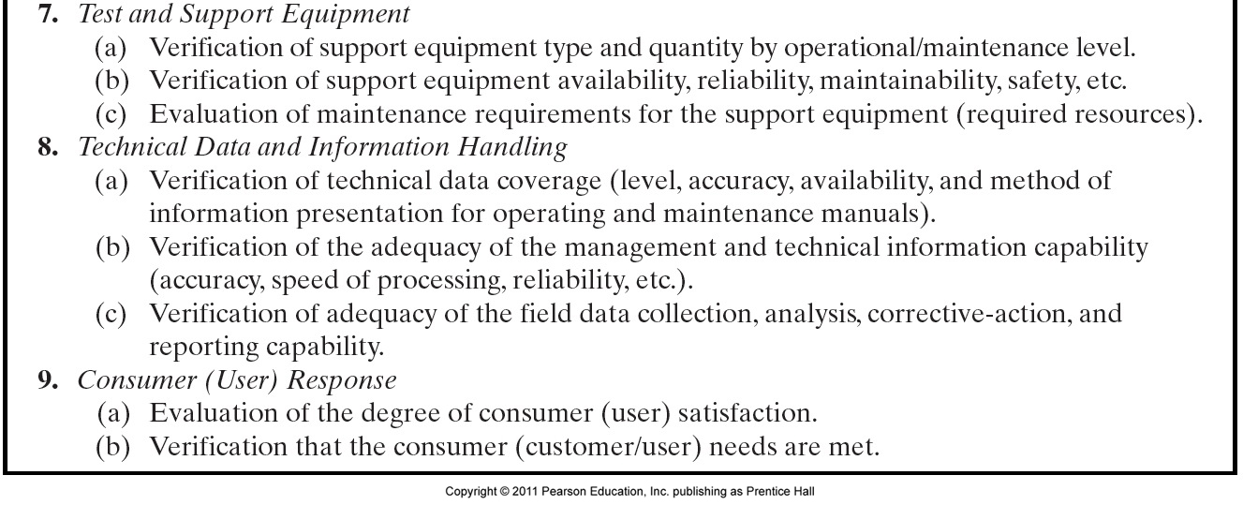
Figure 6.4 (continued) System test, evaluation, and validation checklist (example).

Slide 48
Feedback and System Design Modification
With the proper data recorded, the next step involves that of processing, accomplishing the appropriate analysis, evaluation, reporting, and feedback.
It is important that the right information be reported and fed back to the responsible engineering and management Personnel in an expeditious manner.
They need to know exactly how the system is performing against specifications in the field quickly, so that design modifications can be initiated.

Slide 49
The process illustrated in Figure 6.5 includes steps that cover data collection, analysis, Reporting, and feedback.
Although the primary objective is to provide a good assessment of just how well the system is performing in the user's operational environment, a secondary objective is to identify any problems that may be detected and to initiate the required steps leading to corrective action and the incorporation of necessary design changes and system modifications as required.
Referring to Figure 6.5, the results of the data collection, analysis, reporting, and feedback process may indicate a problem pertaining to not meeting a given TPM (or equivalent) requirement.

Slide 50
Through a subsequent analysis, the proper cause-and-effect relationships are established and the results may point to a deficiency in an element of prime equipment, a software module, an element of the maintenance support infrastructure, an interface problem with one or more other systems within the same SOS, and/or some procedure or process.
As a result, a design change is initiated through the processing of an engineering change proposal (ECP).
The process discussed in Section 5.9 (and illustrated in Figure 5.11) is applicable in the review, evaluation, and implementation of needed system changes and modifications resulting from testing.

Slide 51
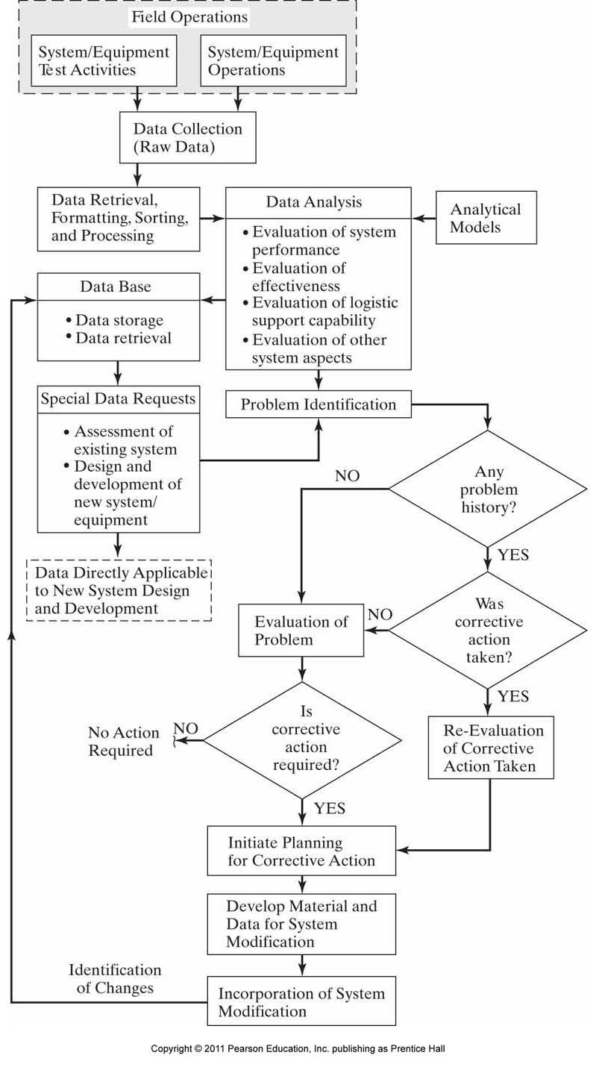
Figure 6.5 System evaluation and corrective action loop.

